Slide 1

AI-Powered Accounting for Africa
AI-driven Accounting & Tax Automation
SYSCOHADA · Senegal & OHADA Zone (17 countries)
GITEX AFRICA 2026 · Marrakech
www.korametrics.com

Slide 2




The Problem
80% of African accountants' time
is spent on manual data entry
Massive manual entry
Costly tax errors
Hundreds of invoices processed by hand every month
Tax penalties, permanent non-compliance risks
Impossible to scale
Inadequate tools
Growth capped by manually processable volume
Sage, Cegid, Excel: no local tax automation

Slide 3



The Kora Metrics Solution
Humans always decide. AI proposes, the professional validates.
01
02
03
Digitization & Extraction
AI Tax Analysis
Ready-made Declarations
→
→
Upload invoices (PDF, scans, photos).
AI automatically extracts all data.
SYSCOHADA allocation, tax identification,
real-time anomaly detection.
Auto-generate VAT, CIT, withholdings.
Professional validates and submits.

Slide 4



Why Now?
Tax Digitalization
Senegal accelerating electronic tax declarations
AI Revolution
New technologies finally enable document analysis at scale
Industry Evolution
Industry professionals are increasingly demanding
Strong need for locally adapted solutions
We integrate domain expertise and technical knowledge

Slide 5
Competition & Differentiation
Excel/Manual
Sage
Cegid
Kora Metrics
Invoice OCR
✗
✗
✗
✓
SYSCOHADA Analysis
✗
✗
✗
✓
Local Tax Declarations
✗
✗
✗
✓
Native AI
✗
✗
✗
✓
Multi-country OHADA
✗
✗
✗
✓
Africa-adapted Pricing
✗
✗
✗
✓

Slide 6
Traction & Proof
70-80%
4
3
17
time savings
proven on MVP
functional
AI modules
committed
accounting firms
addressable
OHADA countries
MVP finalized — Beta test with SENCAS (Dakar) starting April 2026
2 additional firms committed in Benin and Ivory Coast
Modules: OCR+Tax, Bank reconciliation, VAT, Payroll

Slide 7
Business Model
B2B SaaS Subscription · Recurring Revenue
Starter
Pro
Enterprise
25,000 XOF/mo
75,000 XOF/mo
180,000+ XOF/mo
~€38
~€114
~€274
Small firms
1-3 employees
Structured firms
Advanced modules
Large firms
Customization + API

Slide 8
Market & Opportunity
TAM
17 OHADA countries
Tens of thousands of firms & SMEs
SAM
Senegal
300+ accounting and tax firms
SOM
50 clients · Year 1
150 clients · Year 3
Note : 1 accounting firm manages minimum 10 companies. We bill per company

Slide 9
Go-to-Market
Phase 1 · M1-3
Phase 2 · M4-6
Phase 3 · M7-12
Direct sales
& validation
Scale
acquisition
Growth
& expansion
→
→
1-3 paying clients
SENCAS beta test
10-15 clients
Client testimonials
50+ clients
3 OHADA countries
Acquisition Channels
WhatsApp (zero cost)
LinkedIn thought leadership
Institutional partnerships (OEC, ADEPME)
Video content & demos

Slide 10
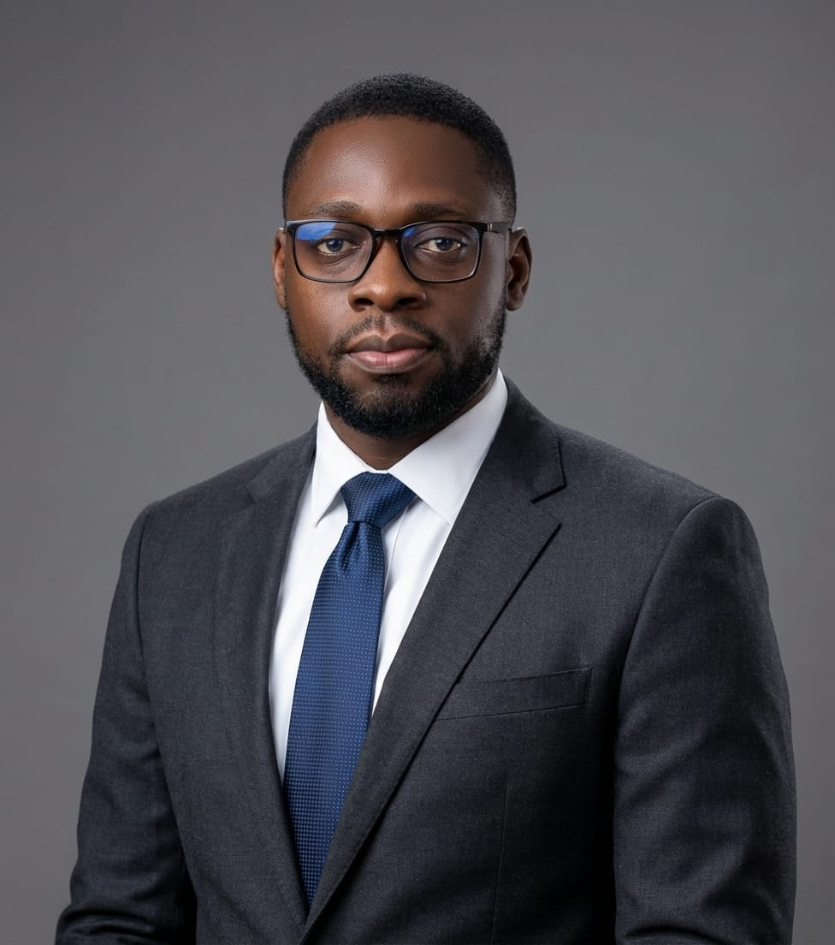
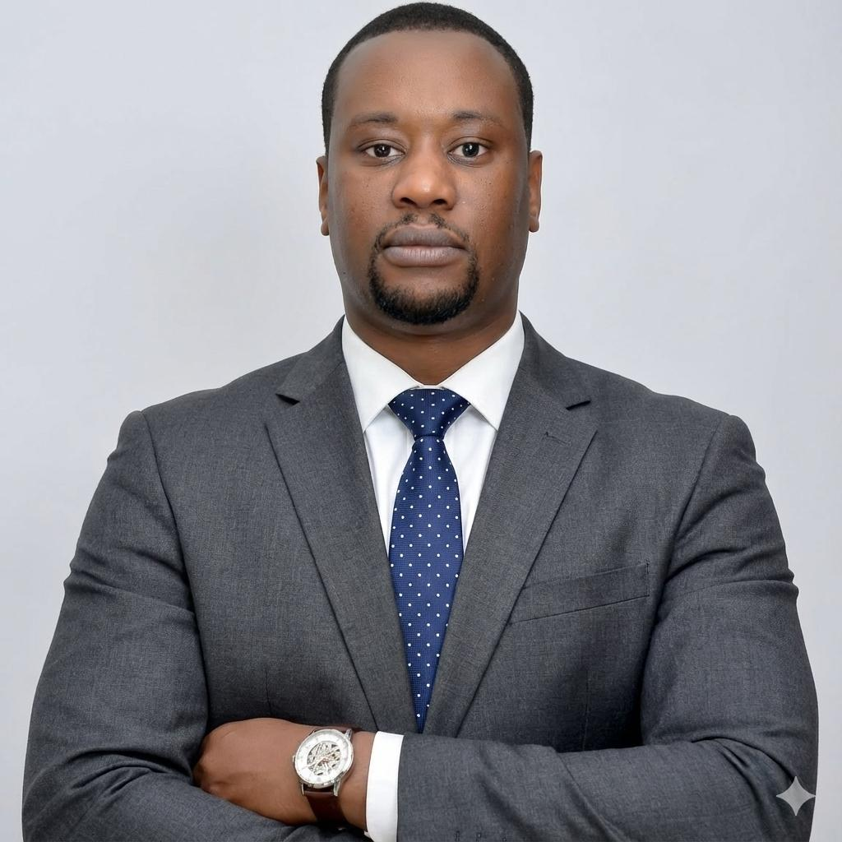
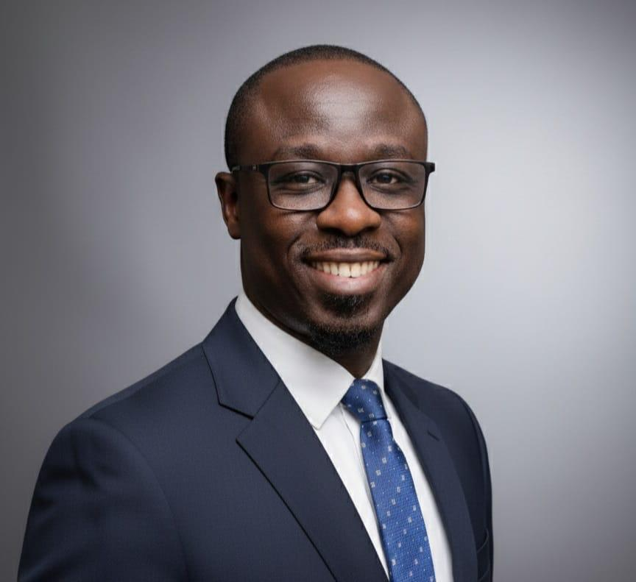
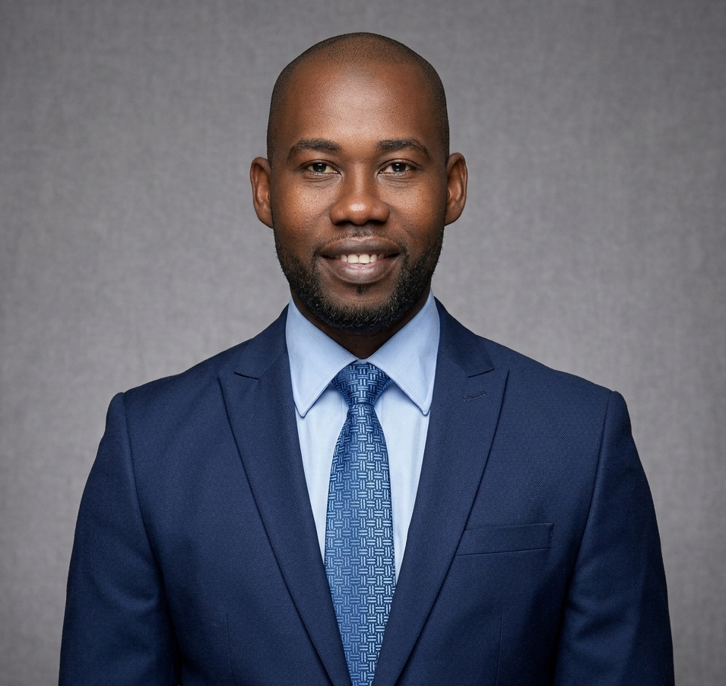
The Team
66 years combined experience · Finance, Tax, Technology & Law
Sédar H. Senghor
Medoune Ndiaye
Cheikh A.T. Diouf
Alassane Boye
CEO
CTO
Tax Director
Operations Dir.
16y · Finance, Strategy,
Accounting & Tax
École de Guerre Économique Paris
15y · Solutions Architecture
& AI · Ex-Microsoft
ERP deployments Africa & ME
15y · Tax law specialist
Former firm tax director
Tax automation expert
20y · Business law, Tax
Consulting & Management
Legal & tax firm leadership

Slide 11
Roadmap & Funding
Key Milestones
Pre-seed Raise
300 000 €
2-year runway
H1 2026
Beta test · First 15 paying clients
Salaries (3 co-founders + hires)
€238,000
79%
H2 2026
Infrastructure & Cloud
€39,000
13%
50 clients · Expand to Benin & Ivory Coast
Marketing & Sales
€27,000
9%
2027
100+ clients · 3 countries · Full ERP integration

Slide 12



Join the African accounting revolution
contact@korametrics.com
+221 77 182 39 26 (Sédar)
+221 78 137 91 90 (Medoune)
www.korametrics.com
GITEX AFRICA 2026 · Marrakech · April 7-9

